Slide 1
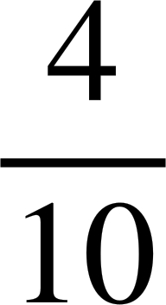
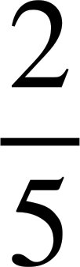
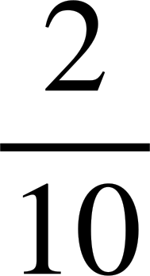
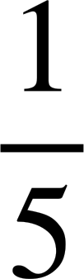
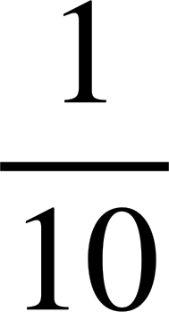
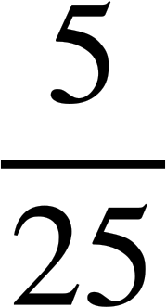
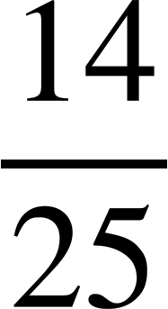
Calculating theoretical probabilities from two-way tables (two events)
Task A: Theoretical probabilities
1) This spinner is going to be spun once.
a) Fill in the outcome table for the two events: less than 12 and prime.
2
4
5
7
20
8
16
13
11
10
less than 12
not less than 12
b) Find P(less than 12 and prime)
2
5
7
13
= = = 0.4 = 40%
prime
11
c) Find P(not prime and not less than 12)
not prime
4
8
16
20
= = = 0.2 = 20%
10
d) Find P(prime and not less than 12)
= = 0.1 = 10%
2) This spinner is going to be spun twice and then the product of the two numbers is found.
5
1
4
2
a) Complete the outcome table to show the possible products.
3
spin 1
1
2
3
4
5
b) Find P(square and factor of 36)
1
1
2
3
4
5
= = = 0.2 = 20%
2
2
4
6
8
10
spin 2
3
3
6
9
12
15
4
4
8
12
16
20
c) Find P(even and less than 18)
5
5
10
15
20
25
= = 0.56 = 56%

Slide 2
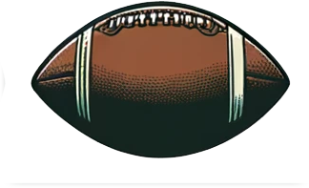
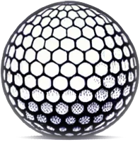
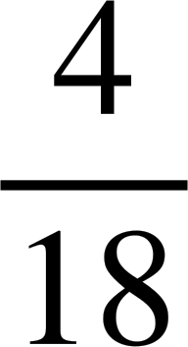
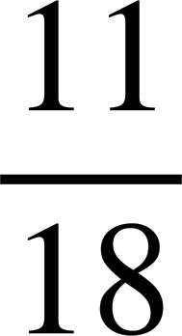
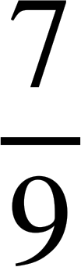
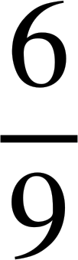
Calculating theoretical probabilities from two-way tables (two events)
3) This two-way table shows the frequencies of some sports balls categorised by their shape and whether they have stitching on the surface.
e.g. an american football is not spherical but has stitching, whereas a golf ball is spherical but doesn’t have stitching.
not spherical
A ball is selected at random.
spherical
total
a) Find P(spherical and has stitching)
stitching
4
1
5
no stitching
11
2
13
total
15
3
18
b) Find P(spherical and does not have stitching)
Task B: Probabilities for combined events
1) This outcome table shows the sample space {1, 2, 3, 4, 5, 6, 7, 8, 9}.
not a factor of 18
factor of 18
An outcome is going to be randomly selected.
Find the probability it is:
even
2
6
4 8
a) even and a factor of 18 or odd
odd
1
3
9
5
7
b) odd and a factor of 18 or even
c) a factor of 18 or even and not a factor of 18
d) not a factor of 18 or even
Mathematics in Education and Industry
v2.3

